Slide 1
Funny Moment
-Hangzhou
—West Lake
Group 4

Slide 2
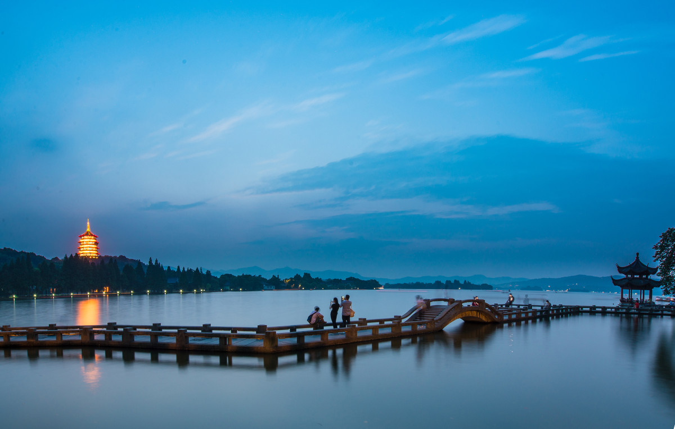


Introduction
West lake,
located to the west of hangzhou, zhejiang province, is one of the first national key scenic spots and one of the top 10 scenic spots in China.It's worth a visit.

Slide 3
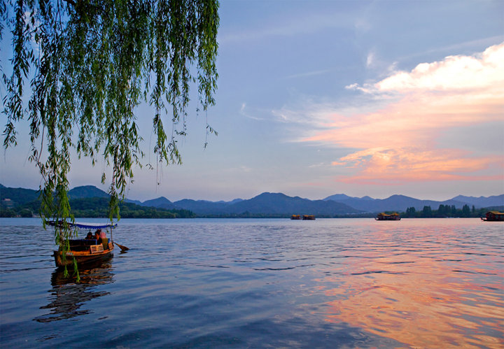
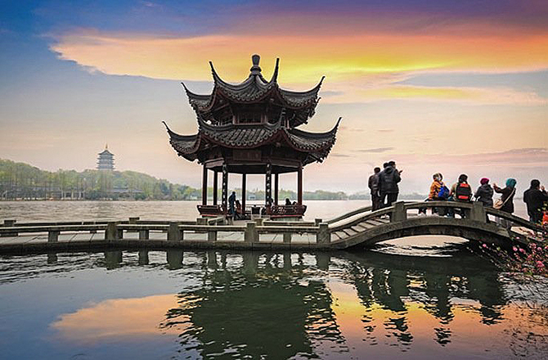
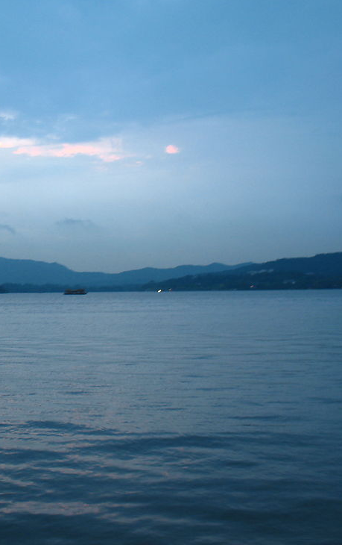
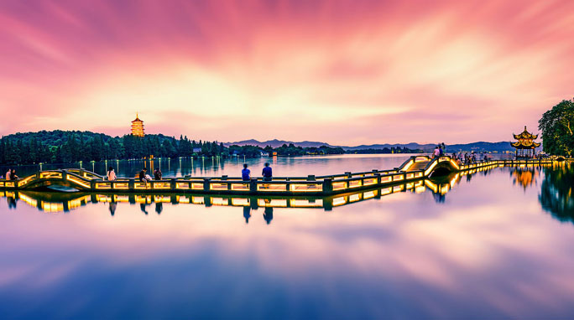
Beauty show

Slide 4
Funny
My Trip
Moment

Slide 5
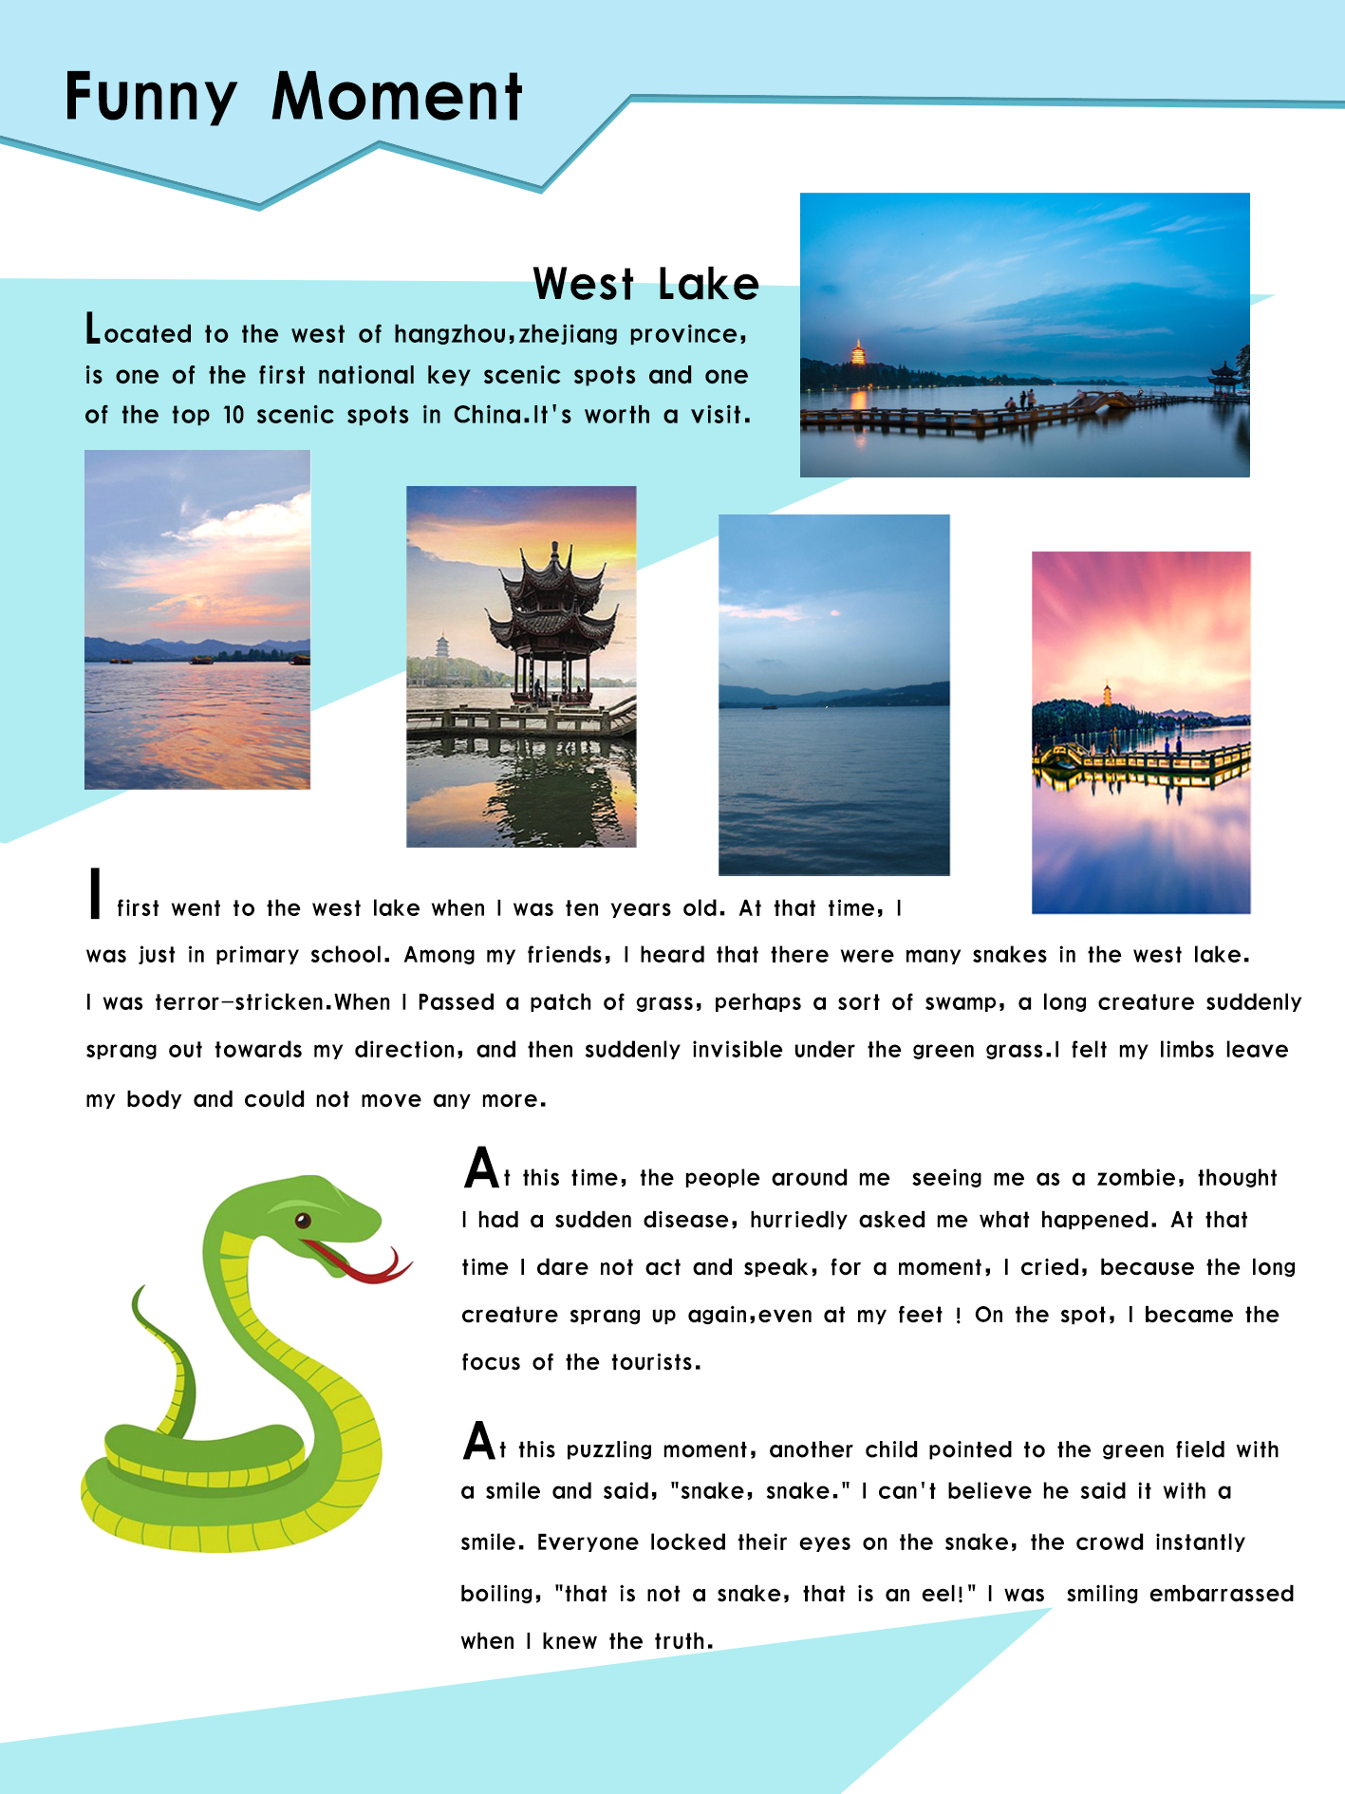


My Magzine Page

Slide 6

Funny Moment
I first went to the west lake when I was ten years old. At that time, I was just in primary school. Among my friends, I heard that there were many snakes in the west lake. I was terror-stricken.When I Passed a patch of grass, perhaps a sort of swamp, a long creature suddenly sprang out towards my direction, and then suddenly invisible under the green grass.I felt my limbs leave my body and could not move any more.

Slide 7
Funny Moment
At this time, the people around me seeing me as a zombie, thought I had a sudden disease, hurriedly asked me what happened. At that time I dare not act and speak, for a moment, I cried, because the long creature sprang up again,even at my feet ! On the spot, I became the focus of the tourists.

Slide 8

Funny Moment
At this puzzling moment, another child pointed to the green field with a smile and said, "snake, snake." I can't believe he said it with a smile. Everyone locked their eyes on the snake, the crowd instantly boiling, "that is not a snake, that is an eel!" I was smiling embarrassed when I knew the truth.

Slide 9
Welcome to
next part
Thanks for
watching

